Slide 1

Bipolar Prediction
With Voting Classifier

Slide 2
Metode
Model
Hyperparameter Optimization
Evaluation Metrics
Voting
Classifier
Random Forest
Grid Search
Accuracy
Best Accuracy
Ada Boost
10 Folds Stratified Cross Validation
Recall
Best Recall
Gradient Boosting
Precision
Best Precision
Extra Tree
F1-Score
Best F1-Score
SVM

Slide 3
Data
Terdapat 57 Kata/variabel yang digunakan yang dikodekan menggunakan CountVectorizer
addict, alcohol, anger, anxious, appetite, balance, breathe, bulimia, communicate, concentrate, confuse, cry, delusion, depress, digestive, distrust, dizzy, drug, eat, echolalia, emotion, empty, excess, faint, fluctuation, forget, guilt, harm, hatred, headache, heartbeat, hopeless, impulsive, insomnia, lazy, libido, lonely, mood, nausea, numb, obsessive, overreact, panic, paranoia, respond, sad, scare, stress, suicide, sweat, tire, trauma, tremble, violence, weight, withdrawal, worry,
Data Imbalanced sehingga akan menggunakan Stratified Cross Validation dengan seed 27 sehingga seluruh model akan dievaluasi pada data yang sama

Slide 4
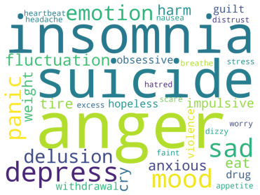
Data
Gejala | Jumlah
depress, anger, insomnia, suicide | 8
mood, sad | 7
emotion, panic | 5
fluctuation, delusion | 4
impulsive, anxious, cry, harm, tire, weight, eat | 3
violence, obsessive, guilt, drug, withdrawal, hopeless | 2
distrust, dizzy, faint, heartbeat, excess, nausea, appetite, breathe, worry, stress, hatred, scare, headache | 1
Gejala pada Bipolar
Gejala dari 23 orang. Ada 36 gejala berbeda. Masih ada 20 gejala yang belum ada pada bipolar : addict, alcohol, balance, bulimia, communicate, concentrate, confuse, digestive, echolalia, empty, forget, lazy, libido, lonely, numb, overreact, paranoia, respond, sweat, trauma, tremble

Slide 5
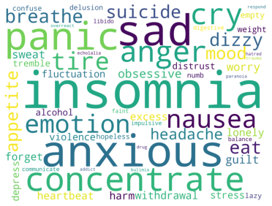
Data
Gejala | Jumlah
insomnia | 42
anxious | 31
sad | 29
panic | 27
concentrate | 20
anger, cry | 18
emotion, nausea | 13
breathe, tire | 12
dizzy, suicide, eat | 11
appetite, headache, mood | 10
obsessive | 9
guilt, worry, sweat | 8
heartbeat, withdrawal, forget, excess, lonely, harm | 7
violence, fluctuation, stress, depress | 6
distrust, tremble, alcohol | 5
empty, weight | 4
numb, lazy, hopeless, confuse, delusion | 3
balance, digestive, libido, faint, communicate, impulsive | 2
overreact, echolalia, addict, hatred, drug, trauma, respond, paranoia, bulimia | 1
Gejala pada Non-Bipolar
Gejala dari 133 orang. Hanya ada 1 gejala yang ada pada Bipolar tetapi tidak ada pada Non-Bipolar yaitu Scare

Slide 6
Hyperparameter Space
Support Vector Machine
Random Forest dan Extra Tree
kernel : linear, poly, rbf, sigmoid,
C : 0.001, 0.1001, 0.2001,…, 20
gamma : scale, auto,
degree : 3, 4, 5, 6
n_estimators : 50, 100, …, 500
criterion : gini, entropy,
max_depth : None, 5, 10,
min_samples_split : 2, 4, 6, 8,
min_samples_leaf : 1, 3, 5
Gradient Boosting
Ada Boost
n_estimators : 100, 200, …, 500
learning_rate : 0.0001, 0.0002, 0.0004, …, 0.38
min_samples_split : 2, 4, 6, 8
min_samples_leaf : 1, 3, 5,
max_depth : 2, 3, 4
n_estimators : 50, 100, …, 500
learning_rate : 0.0001, 0.0002, 0.0004, …, 0.48

Slide 7
Hasil Pemodelan
Jumlah model yang dibuat
Model | Jumlah
Random Forest | 720
Ada Boost | 225
Gradient Boosting | 3,600
Extra Tree | 720
SVM | 6,400
Total | 11,665

Slide 8
Hasil Pemodelan
Model dengan recall terbaik. Karena terdapat dua model dengan nilai recall terbaik sama maka dipilih yang F1-Score lebih tinggi
Model | hyperparameter | Recall | Precision | F1-Score | Accuracy
GradientBoostingClassifier | {'learning_rate': 0.1401, 'max_depth': 2, 'min_samples_leaf': 3, 'min_samples_split': 8, 'n_estimators': 400} | 0.483333 | 0.336667 | 0.374286 | 0.807917
GradientBoostingClassifier | {'learning_rate': 0.1401, 'max_depth': 2, 'min_samples_leaf': 3, 'min_samples_split': 8, 'n_estimators': 500} | 0.483333 | 0.313333 | 0.360476 | 0.78875
GradientBoostingClassifier | {'learning_rate': 0.3601, 'max_depth': 2, 'min_samples_leaf': 3, 'min_samples_split': 6, 'n_estimators': 100} | 0.466667 | 0.378333 | 0.410476 | 0.82

Slide 9
Hasil Pemodelan
Model dengan precision terbaik.
Model | hyperparameter | Recall | Precision | F1-Score | Accuracy
GradientBoostingClassifier | {'learning_rate': 0.0201, 'max_depth': 2, 'min_samples_leaf': 3, 'min_samples_split': 8, 'n_estimators': 300} | 0.3 | 0.583333 | 0.38 | 0.87125
GradientBoostingClassifier | {'learning_rate': 0.040100000000000004, 'max_depth': 3, 'min_samples_leaf': 5, 'min_samples_split': 2, 'n_estimators': 100} | 0.283333 | 0.55 | 0.363333 | 0.890833
GradientBoostingClassifier | {'learning_rate': 0.040100000000000004, 'max_depth': 3, 'min_samples_leaf': 5, 'min_samples_split': 4, 'n_estimators': 100} | 0.283333 | 0.55 | 0.363333 | 0.890833

Slide 10
Hasil Pemodelan
Model dengan F1-Score terbaik
Model | hyperparameter | Recall | Precision | F1-Score | Accuracy
GradientBoostingClassifier | {'learning_rate': 0.0801, 'max_depth': 2, 'min_samples_leaf': 3, 'min_samples_split': 8, 'n_estimators': 100} | 0.4 | 0.55 | 0.44 | 0.871667
GradientBoostingClassifier | {'learning_rate': 0.1601, 'max_depth': 2, 'min_samples_leaf': 3, 'min_samples_split': 2, 'n_estimators': 100} | 0.416667 | 0.466667 | 0.43 | 0.865417
GradientBoostingClassifier | {'learning_rate': 0.0201, 'max_depth': 2, 'min_samples_leaf': 3, 'min_samples_split': 6, 'n_estimators': 500} | 0.4 | 0.5 | 0.43 | 0.865417

Slide 11
Hasil Pemodelan
Model dengan akurasi terbaik. Semua memiliki evaluasi matriks yang sama sehingga akan dipilih yang mana saja
Model | hyperparameter | Recall | Precision | F1-Score | Accuracy
GradientBoostingClassifier | {'learning_rate': 0.040100000000000004, 'max_depth': 3, 'min_samples_leaf': 5, 'min_samples_split': 6, 'n_estimators': 100} | 0.283333 | 0.55 | 0.363333 | 0.890833
GradientBoostingClassifier | {'learning_rate': 0.040100000000000004, 'max_depth': 3, 'min_samples_leaf': 5, 'min_samples_split': 8, 'n_estimators': 100} | 0.283333 | 0.55 | 0.363333 | 0.890833
GradientBoostingClassifier | {'learning_rate': 0.040100000000000004, 'max_depth': 3, 'min_samples_leaf': 5, 'min_samples_split': 4, 'n_estimators': 100} | 0.283333 | 0.55 | 0.363333 | 0.890833

Slide 12
Voting Classifier
Model | Recall | Precision | F1-Score | Accuracy
Best Recall | 0.483333 | 0.336667 | 0.374286 | 0.807917
Best Precision | 0.3 | 0.583333 | 0.38 | 0.87125
Best F1-Score | 0.4 | 0.55 | 0.44 | 0.871667
Best Accuracy | 0.283333 | 0.55 | 0.363333 | 0.890833
Voting Classifier | 0.43333 | 0.60 | 0.48 | 0.88
Digunakan pada voting classifier dengan hard voting
Precision dan F1-Score naik, untuk akurasi berkurang sedikit dan nilai recall ternyata yang sangat menurun

Slide 13
Voting Classifier
Model | 10-Fold CV | One Leave out
Recall | 0.43 | 0.26
Precision | 0.60 | 0.60
F1-Score | 0.48 | 0.36
Accuracy | 0.88 | 0.87
Confusion Matrix dari One Leave Out
TRUE/Predict | Positive | negative
POSITIVE | 6 | 17
NEGATIVE | 4 | 129
Metrics evaluasinya menurun ketika menggunakan one leave out

Slide 14
Penambahan Decision Tree

Slide 15
Hyperparameter Space
Decision Tree
criterion : gini, entropy,
max_depth : 1, 2, …, 10
min_samples_split : 1, 2, …, 10
min_samples_leaf : 1, 2, …, 10
Jumlah model yang dibuat
2,000 model

Slide 16
Hasil Pemodelan
Model dengan precision terbaik. Model decision tree mengalahkan model GradientBoosting jika dilihat dari precisionnya. Tetapi untuk recall, f1-score dan accuracy masih sesuai dengan hasil sebelumnya . Sehingga voting classifier untuk precision terbaik akan diganti dengan Decision Tree
Model | hyperparameter | Recall | Precision | F1-Score | Accuracy
DecisionTreeClassifier | {'criterion': 'gini', 'max_depth': 3, 'min_samples_leaf': 5, 'min_samples_split': 2} | 0.283333 | 0.6 | 0.38 | 0.87875
DecisionTreeClassifier | {'criterion': 'gini', 'max_depth': 3, 'min_samples_leaf': 5, 'min_samples_split': 3} | 0.283333 | 0.6 | 0.38 | 0.87875
DecisionTreeClassifier | {'criterion': 'gini', 'max_depth': 3, 'min_samples_leaf': 5, 'min_samples_split': 4} | 0.283333 | 0.6 | 0.38 | 0.87875

Slide 17
Voting Classifier
Model | Recall | Precision | F1-Score | Accuracy
Best Recall | 0.483333 | 0.336667 | 0.374286 | 0.807917
Best Precision | 0.283333 | 0.6 | 0.38 | 0.87875
Best F1-Score | 0.4 | 0.55 | 0.44 | 0.871667
Best Accuracy | 0.283333 | 0.55 | 0.363333 | 0.890833
Voting Classifier | 0.43333 | 0.60 | 0.48 | 0.88
Voting Classifier dengan Decision Tree | 0.467 | 0.60 | 0.51 | 0.878
Digunakan pada voting classifier dengan hard voting
Terlihat bahwa voting classifier dengan memasukkan decision tree recall dan F-1 scorenya lebih tinggi dibandingkan dengan tanpa memasukkan decision tree. Meskipun terdapat sedikit penurunan pada accuracy

Slide 18
Voting Classifier
Confusion Matrix dari One Leave Out Tanpa Memasukkan Decision Tree
Model | 10-Fold CV |  | One Leave out
 | Tanpa Decision Tree | Dengan Decision Tree | Tanpa Decision Tree | Dengan Decision Tree
Recall | 0.43 | 0.47 | 0.26 | 0.30
Precision | 0.60 | 0.58 | 0.60 | 0.64
F1-Score | 0.48 | 0.50 | 0.36 | 0.41
Accuracy | 0.88 | 0.87 | 0.87 | 0.87
TRUE/Predict | Positive | negative
POSITIVE | 6 | 17
NEGATIVE | 4 | 129
Confusion Matrix dari One Leave Out Dengan Memasukkan Decision Tree
TRUE/Predict | Positive | negative
POSITIVE | 7 | 16
NEGATIVE | 4 | 129
Model voting classifier dengan memasukkan Decision Tree terlihat lebih baik terutama ketika model di evaluasi dengan One Leave Out

Slide 19
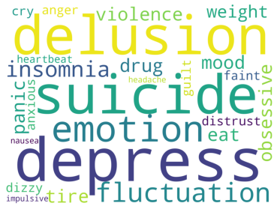
Berhasil Memprediksi Bipolar
Gejala | Jumlah
depress | 5
delusion, suicide | 4
emotion, fluctuation, insomnia | 3
violence, weight, panic, ear, tire, obsessive, mood, drug | 2
distrust, anger, anxious, cry, dizzy, faint, impulsive, nausea, guilt, headache | 1
Gejala dari 7 orang

Slide 20
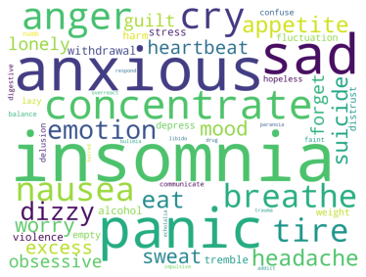
Berhasil Memprediksi Non-Bipolar
Gejala | Jumlah
insomnia | 41
anxious | 31
sad, panic | 26
concentrate | 20
anger | 17
cry | 16
nausea | 13
emotion, tire, breathe | 12
dizzy | 11
headache, appetite, eat | 10
suicide | 9
Gejala dari 129 orang. Masih ada 40 gejala lainnya

Slide 21
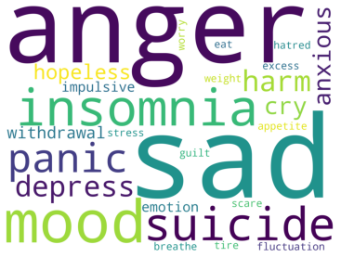
Gagal Memprediksi Bipolar
Gejala | Jumlah
anger, sad | 7
mood, insomnia | 5
suicide | 4
harm, panic, depress | 3
emotion, withdrawal, hopeless, cry, anxious, impulsive | 2
guilt, worry, fluctuation, hatred, stress, tire, breathe, appetite, weight, eat, excess, scare | 1
Gejala dari 16 orang

Slide 22
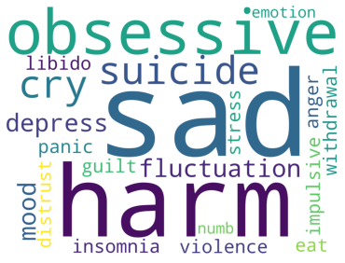
Gagal Memprediksi Non-Bipolar
Gejala | Jumlah
sad | 3
harm, obsessive, suicide, cry, depress, mood, fluctuation | 2
libido, emotion, withdrawal, stress, insomnia, eat, guilt, impulsive, distrust, anger, violence, panic, numb | 1
Gejala dari 4 orang

Slide 23
Berhasil Memprediksi Bipolar vs Non-Bipolar
Gejala yang dialami ketika model Berhasil Memprediksi Bipolar
Gejala yang dialami ketika model Berhasil Memprediksi Non-Bipolar

Slide 24
Berhasil Memprediksi Bipolar vs Non-Bipolar
Gejala yang dialami ketika model Berhasil Memprediksi Non-Bipolar
Gejala yang dialami ketika model Berhasil Memprediksi Bipolar
Gejala | Jumlah
insomnia | 41
anxious | 31
sad, panic | 26
concentrate | 20
anger | 17
cry | 16
nausea | 13
emotion, tire, breathe | 12
dizzy | 11
headache, appetite, eat | 10
suicide | 9
Gejala | Jumlah
depress | 5
delusion, suicide | 4
emotion, fluctuation, insomnia | 3
violence, weight, panic, ear, tire, obsessive, mood, drug | 2
distrust, anger, anxious, cry, dizzy, faint, impulsive, nausea, guilt, headache | 1

Slide 25
Gagal Memprediksi Bipolar vs Non-Bipolar
Gejala yang dialami ketika model Gagal Memprediksi Bipolar
Gejala yang dialami ketika model Gagal Memprediksi Non-Bipolar

Slide 26
Gagal Memprediksi Bipolar vs Non-Bipolar
Gejala yang dialami ketika model Gagal Memprediksi Bipolar
Gejala yang dialami ketika model Gagal Memprediksi Non-Bipolar
Gejala | Jumlah
insomnia | 41
anxious | 31
sad, panic | 26
concentrate | 20
anger | 17
cry | 16
nausea | 13
emotion, tire, breathe | 12
dizzy | 11
headache, appetite, eat | 10
suicide | 9
Gejala | Jumlah
sad | 3
harm, obsessive, suicide, cry, depress, mood, fluctuation | 2
libido, emotion, withdrawal, stress, insomnia, eat, guilt, impulsive, distrust, anger, violence, panic, numb | 1

Slide 27
TERIMA KASIH

